Slide 1
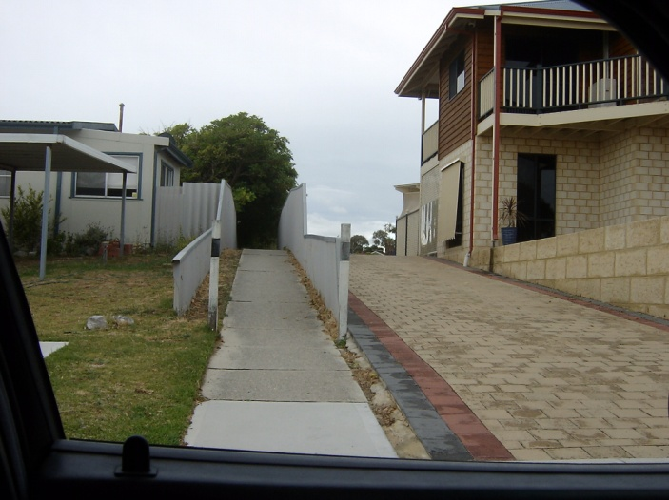
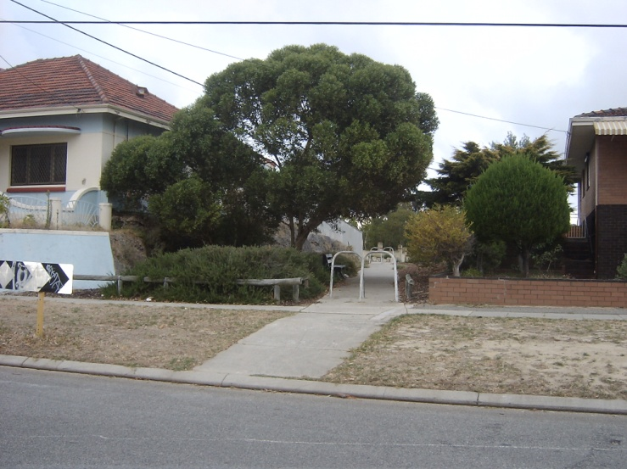
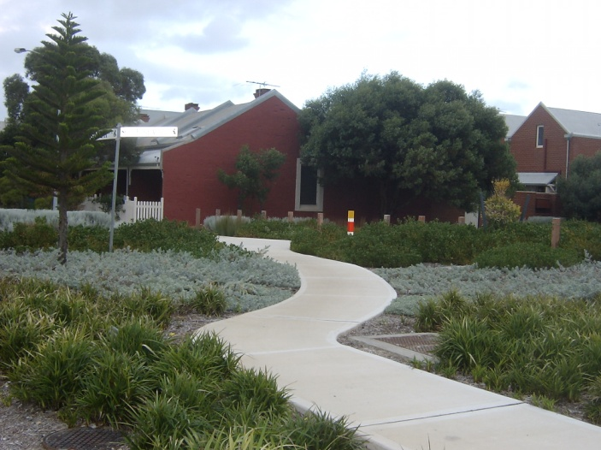
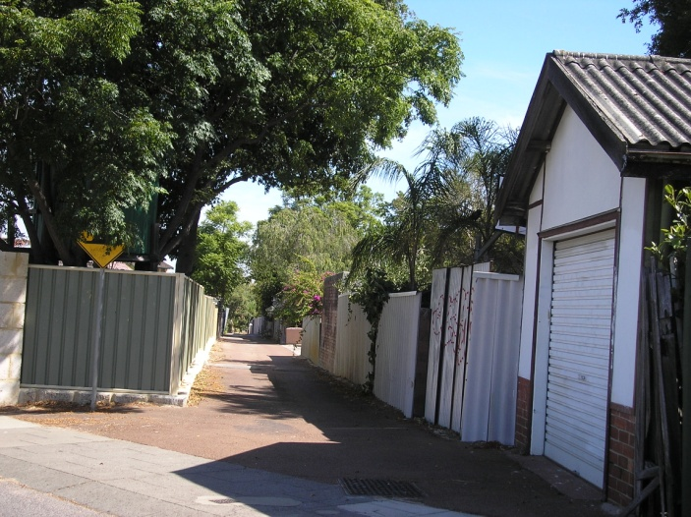
Pedestrian Access Ways in Western Australia
Dr. Terence Love
Dr Paul Cozens
Design Out Crime Research Group
Curtin University of Technology and Edith Cowan University

Slide 2
Examples of PAWs

Slide 3
Pedestrian Access Ways (PAWs)
PAWs are:
physical elements of urban, suburban and peri-urban space
  Narrow footpath PAWs
  Laneway PAWs
Elements of the walking network
Different from road footpaths
Often pseudo-public space

Slide 4
PAW Management Issues
Essential elements of transport system
Important for:
  Health
  Access to shops
  Self directed exercise
Diverse in:
  Type
  User groups
  Purposes
  Functioning
  Dynamics
  Environment
  Location
Complex ownership, management and vesting
Complex anti-social behaviour and crime
Complex for crime prevention

Slide 5
Historical PAW types
Early settlement PAWs;
PAWs in post-war convoluted car-centric suburbs
PAWs in rectilinear developments echoing early settlement planning;
PAWs in recent pedestrian-friendly suburbs
Informal regional and per-urban PAWs.

Slide 6
Road hierarchy (SOR)

Slide 7
Road Hierarchy (NOR)

Slide 8
PAW Morphology – 6 types
Coastal PAWs
PAWs in convoluted suburbs
PAWs providing occasional access for major events
PAWs connected to retail services
Residential laneway PAWs
Industrial laneway PAWs.

Slide 9
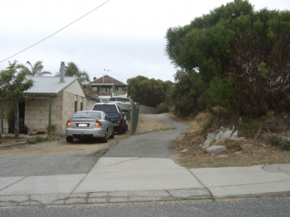
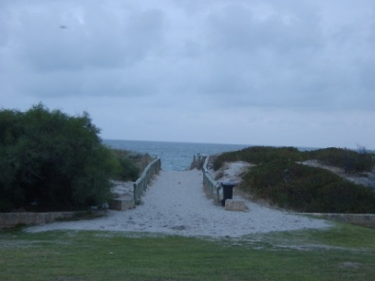
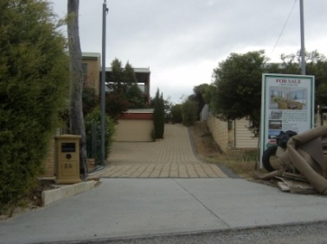
Coastal PAWs
Coastal PAWs provide:
  Access to the beach from nearby streets
  Improved use of backstreet parking for beach visitors from other suburbs
  Access to beaches as elements of longer-distance pedestrian and cycle routes from inland suburbs.
Different seasonal uses and user groups vary by time of day, day of week, and season.
Designing Out Crime strategies target specific seasons, times of day, specific user groups and specific behaviours.
Crowe’s 3-D (Designation, Definition, Design) useful.

Slide 10
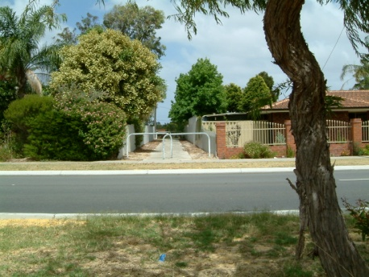
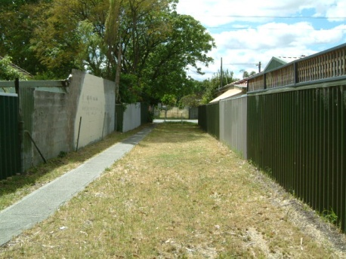
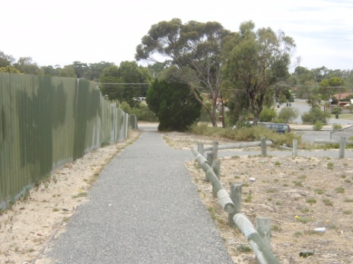
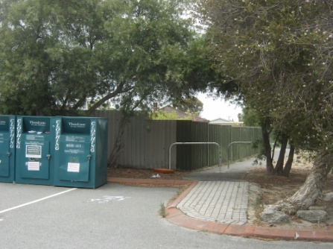
PAWs in post-war convoluted suburbs
PAWs in convoluted suburbs are essential as these suburbs are car-centric and pedestrian-unfriendly with very low ped-shed ratios (~ 0.25 instead of >=0.6).
PAW management context:
  Improving walkability and access (ped-shed index ~ 0.25 rather than >=0.6) this suggests create additional PAWs
  High importance in access and health terms
  Important to non-local walkers and cyclists
  High use PAWs have proportionally higher crime and anti-social behaviour
  poor DOC design of PAWs and residential properties
  high levels of inappropriate territoriality of residents abutting PAWs
  Different patterns of PAW use at different times of day
  Different PAW crime risks and vulnerability at different times of day.

Slide 11

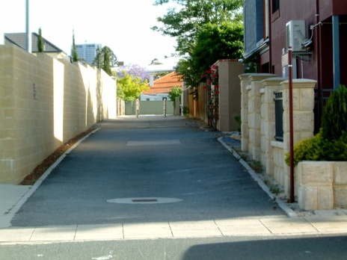
PAWs providing occasional access for major events
Some PAWs, often laneway PAWs, have a sporadic role providing pedestrian access to large public events.
Double life in crime prevention terms.
In public events, are taken over by visiting public with increased crime and anti-social behaviour)
Other times, they typically provide access and exercise for much lower numbers of users (local and longer distance).
Important that interventions for public events do not impact adversely on PAW normal use.
Requires two independent strategies for Designing Out Crime interventions.

Slide 12
PAWs that are a pedestrian connection to a retail services area
Pedestrian networks often centre on retail services as a turning point for walking routines as well as being of practical purpose for shopping.
‘Near to retail’ PAWs have a variety of roles:
  nodes carrying foot and cycle traffic from multiple routes
  pedestrian access between parts of shopping complexes
  pedestrian access from car parks, bus stops and rail stations.
PAWs that centre on retail are typically
  high use, high importance, high risk for antisocial behaviour and crime.
  Have a patchwork of ownerships and management responsibilities because most retail land is privately owned pseudo-public space.
Retail centred PAW management involves:
  multiple stakeholders, constituencies and user groups with different interests and spheres of action
  multiple security organisations with different priorities and specialist expertise (shopping centre security, rail security, police, youth workers, council rangers).

Slide 13
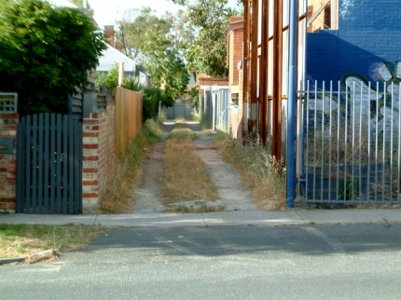
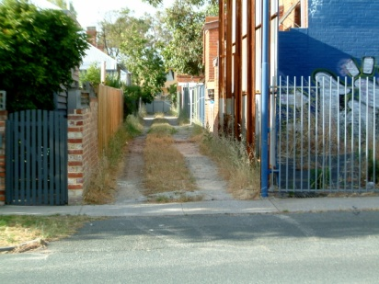

Residential laneway PAWs
Typically secondary use of rear shared-service access roads: often road only and without footpaths.
Legitimate use may extend from early morning to the late evening.
Many part of a longer distance network of paths and carry through-traffic (pedestrian and cycle traffic).
Important to discourage ‘territoriality’ and sense of ‘ownership’ of nearby residents to avoid social tensions between residents and users legitimately using the laneway as part of a walking or cycling route.
Designing Out Crime approaches apply.

Slide 14
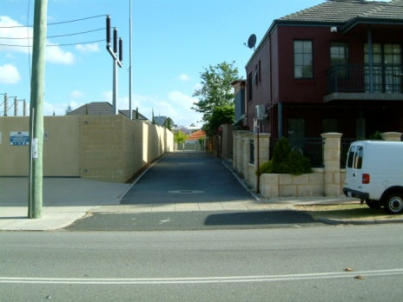
Industrial and commercial laneway PAWs
Laneways in industrial and commercial areas providing:
  service access
  Pedestrian paths for service and customer access.
  Most legitimate usage is in working hours.
  Other pedestrian networks can flow through commercial areas via laneway PAWs.
Design Out Crime applies typically strong target-hardening, electronic surveillance and motion-sensitive or continuous night lighting, provide alternative pedestrian and cyclist routes where public paths have direct routes through.

Slide 15
Understanding PAW functioning
User groups and activities and times
PAW purposes (What a PAW is used for)
PAW functions (What a PAW offers)
Uses at different times of day / days of week / times of year
Long and short distance user groups
PAW environment
PAW location

Slide 16
Information needed
For a PAW:
  Which user groups use the PAW?
  At which times of day?
  For which purposes?
  At which times of year?

Slide 17
Some findings
Planning and crime prevention decisions ‘manufacturing’ crime and anti-social behaviour
Planning processes ‘manufacturing pressure and consent for PAW closure’
Lack of consultation with full range of PAW users and user groups
Lack of consultation with government departments and NGOs with an interest

Slide 18
Government Processes
Ped-shed analyses
Pedestrian Access and Mobility Plans (PCAPS)
Planning Bulletin 57

Slide 19
Ped-Sheds
Two sorts of ped-shed analysis:
  Ped-shed access ratios assessing an area’s walkability and access (preferred by government agencies involved in encouraging activity, health, economic development, sustainability, reducing obesity and reducing car use)
  Ped-sheds ratios for routes to a specific point (preferred by those wishing to advocate PAW closure).
Important : ‘walkability’ of a suburb is different to ‘good access to the bus stop’.
Areas with good walkability have a ped-shed access ratio of >= 0.6.
Post-war convoluted suburbs have ped-shed ratios as low as 0.2. Hence, PAWs essential in convoluted suburbs.

Slide 20
PCAPs
Problematic WA variant on Pedestrian Access and Mobility Plans (PAMPs )and Pedestrian Access Plans (PAPs).
Not formally defined in WA.
WAPC has an internal definition of a PCAP:
  at odds with international best practice
  confuses the two Ped-shed approaches
  adds intention to establish a PAW hierarchy that conflicts badly with the multi-role network situation found in PAWs.
Proposed PCAP assessment conflicts with other government agencies agendas for encouraging activity, health, economic development, sustainability, reducing obesity and reducing car use.
WAPC proposals ‘manufacture consent’ for closure of PAWs
WAPC position presents problems for applying Designing Out Crime strategies.

Slide 21
Planning Bulletin 57
Procedures for closing a PAW based on the WAPC proposal for PCAPs and ped-shed analysis.
Has all problems/errors of PCAPS and Ped-sheds.
Acts against other government agencies agendas
Problems of ownership and control (complex in PAWs).
PB57 apply only to PAWs under jurisdiction of State government institution. Significant number of PAWs outside PB57.

Slide 22
Crime Prevention in PAWs
Understand via PAW ‘types’
Indentify important characteristics
Identify information to be collected
Identify necessary consultation
Identify appropriate DOC opportunities and strategies

Slide 23
Pedestrian path PAWs
Most PAW users live at a distance to the PAW.
Activities are primarily travel-based (walking, cycling, skating etc).
Typically part of a longer route of PAWs, roads, streets, public open space and pseudo-public space.
Complex routine of legitimate activity
Purposes: health (exercise); recreational (walking and cycling for pleasure); functional (walking to catch a bus, taking children to school, shopping etc); and social .
Activities differ at different at times of day, days of week, time of year, involve differing groups of PAW users
Dominated by public space/public equity considerations..
PAW management and crime prevention strategies must take into account ‘whole of government’ issues.
Primarily include ALL PAW user groups in any community participation for crime prevention.
DOC opportunities are best tightly targeted . Avoid encouraging inappropriate territoriality and sense of ownership

Slide 24
Laneway PAWs
Laneway PAWs different and simpler.
Primary users are abutting owners.
Activities include children playing, dog walking, gardening, socialising, home / car repair, cycling or walking or little/no activity.
Community participation in developing DOC strategies is straightforward
Important to include ALL users (including long distance) of the laneway as a travel route.
Two part DOC strategies divided between nearby residents and travellers through the PAW

Slide 25
DOC strategies 1
Improved local government maintenance.
Reduce impression of poor care.
Graffiti management has been implemented effectively.
3-D approach as guide to Designing Out Crime interventions.
Crowe’s 3-D addresses complexities to support achieving ‘whole of government’ benefits.

Slide 26
DOC strategies 2
Designing Out Crime strategies targeting specific problem behaviours/ times of day/ days of week and user groups.
Rethink ped-sheds, PCAPS and PB57
Fulfil government agendas in health, access, walkability, and the establishment of a network of longer-distance cross-suburb walking and cycling routes.

Slide 27
DOC strategies 3
Undertaking improvements to PAWs based on collaboration with PAW USERS (rather than residents near PAWs).
Avoid encouraging territoriality as this results in ‘manufacturing’ of crime and social tensions.
Avoid encouraging local residents to feel they ‘own’ a PAW or nearby areas.
Make PAW closure more difficult.
Increase number of PAWs in convoluted suburbs

Slide 28
Conclusions
Individual PAWs are different in design, use, functionality, contexts, problems and dynamics
Solutions require identifying user groups, roles, purposes, functions, user groups and distribution of different uses and user-groups during the day, week and year.
Management of PAWs requires whole of government approach aligned with agendas of all government agencies and public interests.
Contrary to previous policy direction, this is likely to require deliberate retention of PAWs and increase in number of PAWs in convoluted suburbs.
Designing Out Crime (CPTED) approaches well suited to management of PAWs and can support State, Federal, local government and NGO-related agendas.

Slide 29
Questions? Comments?
Thank You!

